Slide 1


WordPress
Architecture of WordPress.

Slide 2


What we are going to learn in this lecture.
Understanding the functionality of the most common template files used in WordPress.
Understanding the WordPress installation files and folders.
Introduction to phpMyAdmin.
WordPress permalinks.
Creating custom page templates.

Slide 3
Understanding the functionality of the most common template files used in WordPress.
1
5

Slide 4
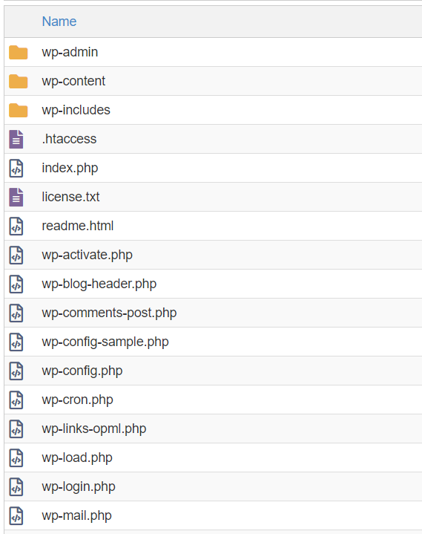
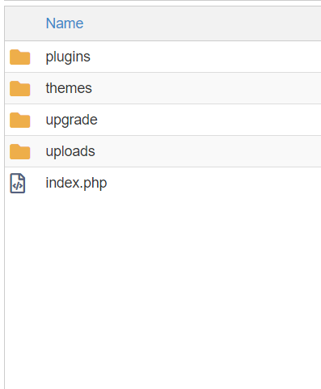
Understanding the functionality of WordPress installation files and folders.
2
5
Root directory.
Themes and plugins folder(inside wp-content)

Slide 5
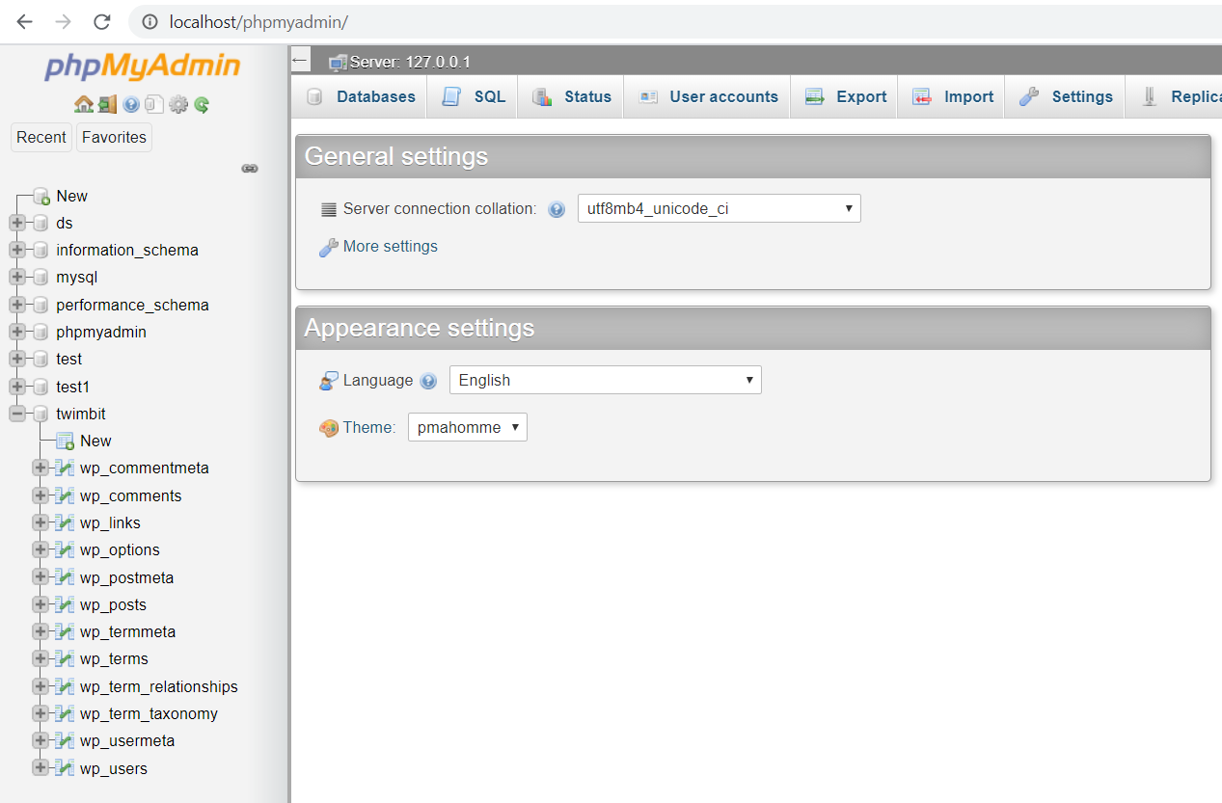
Introduction to phpMyAdmin.
3
5
Database Admin panel

Slide 6
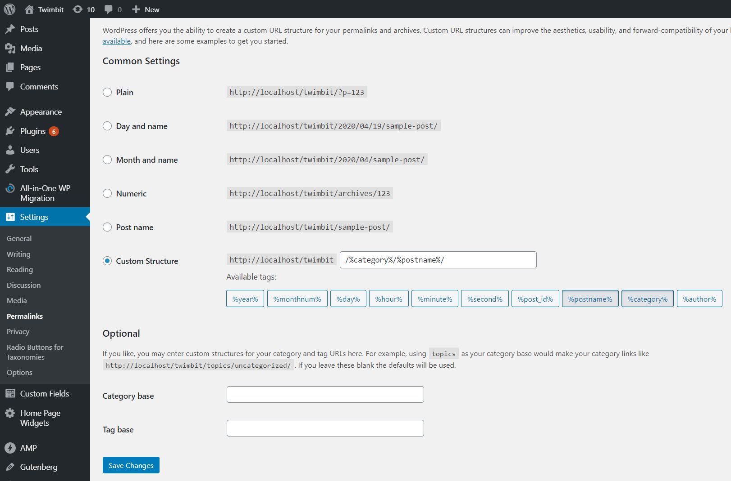
WordPress Permalinks.
4
5

Slide 7
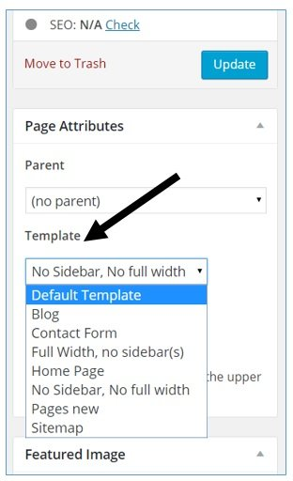
5
5
Creating custom page templates.
Step 1.
Step 2.
Add this code in a template file.
Select Template from Page Attribute.
<?php /* * Template Name: No Sidebar, No full width * Description: Page template without sidebar */ ?>

